Slide 1
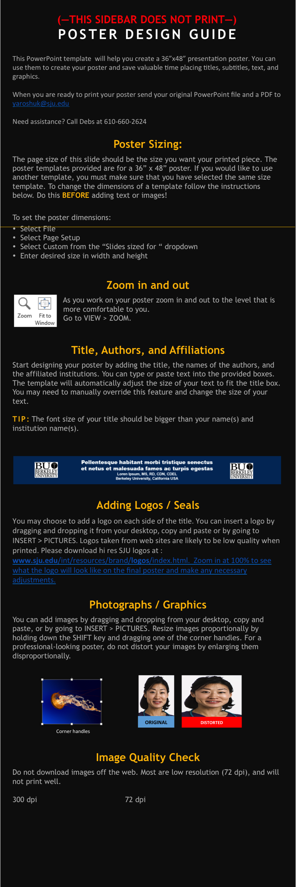
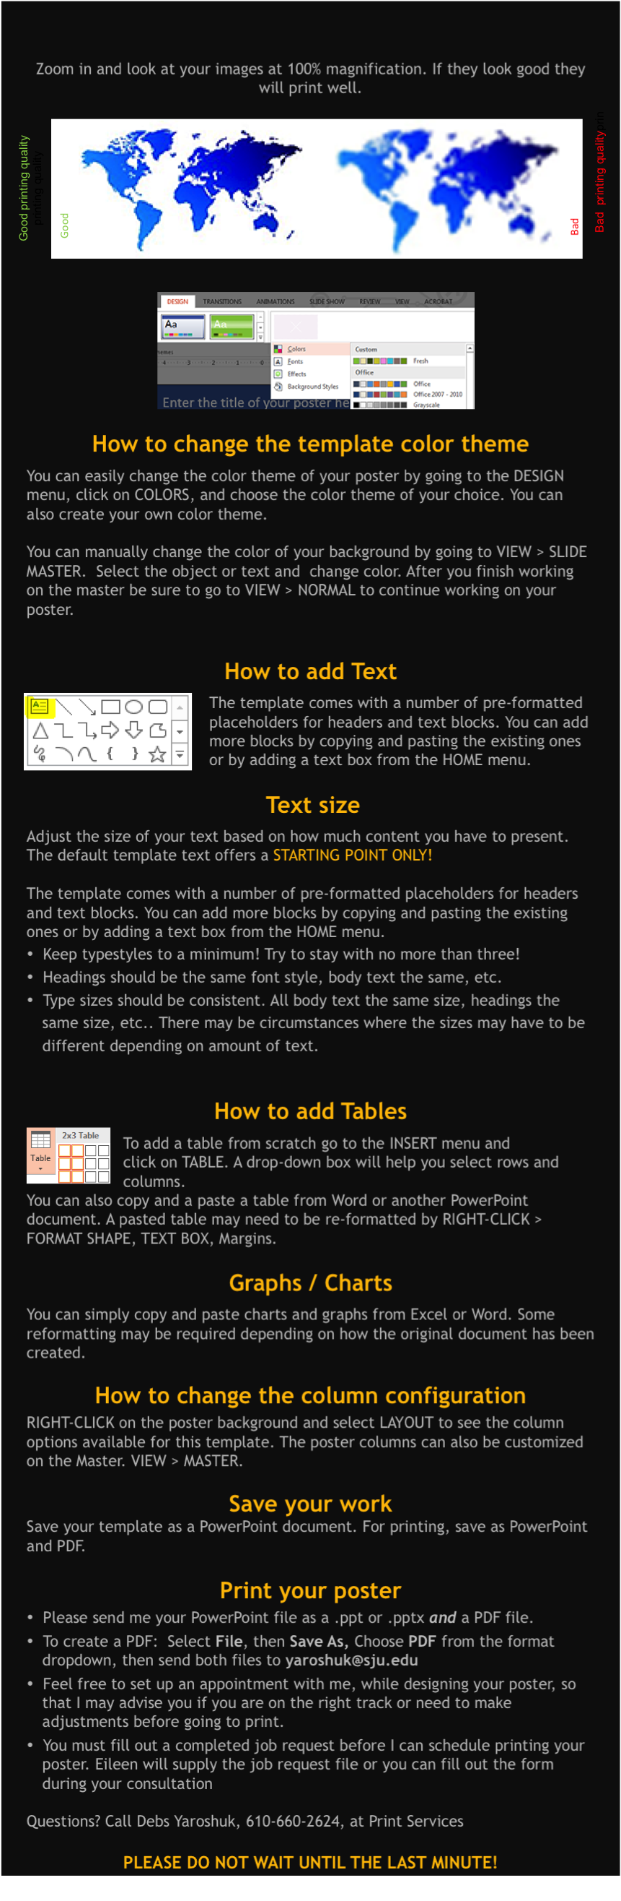





NFL-Picks
REPLACE THIS BOX WITH YOUR ORGANIZATION’S
HIGH RESOLUTION LOGO
REPLACE THIS BOX WITH YOUR ORGANIZATION’S
HIGH RESOLUTION LOGO
Colin Deckert; Lou Dignam; Sean Monahan
Saint Joseph’s University, Department of Computer Science
The Rules
Displaying the Data
Making it User Friendly
The NFL season lasts 17 weeks, with 30 teams. Our project is a website that hosts user-made pools.
Users will use on site credits to buy into a pool.
The user chooses one team every week that they have not yet chosen.
Once they choose this team, they may not choose the team again for the rest of that season for that pool.
If that team wins, the user earns the same amount of points as that team scored.
If the team the user chose loses, the user scores 0 points.
At the end of the season, the user with the most points wins the pool.
The total credits in the pot will be divided up fairly between the top 3 scoring users
PHP is a widely used scripting language that can be easily used to connect to a database and retrieve the data stored in it.
PHP can also be embedded into HTML, which is the standard mark-up language used to create webpages.
Therefore, PHP allowed us to easily fetch the data from our database and display it on our site.
We also chose PHP because it has built-in tools designed specifically for connecting and retrieving data from a MySQL database.
PHP acted as a seamless link between our data and our front-end user interface.
Talk about Javascript and Jquery here
This text box will automatically re-size to your text. To turn off that feature, right click inside this box and go to Format Shape, Text Box, Autofit, and select the “Do Not Autofit” radio button.
To change the font style of this text box: Click on the border once to highlight the entire text box, then select a different font or font size that suits you. This text is Calibri 32pt and is easily read up to 5 feet away on a 36x48 poster.
Zoom out to 100% to preview what this will look like on your printed poster.
Storing the Data
Giving it Style
Taking Inspiration
We chose to use a MySQL database to store our data
MySQL is a commonly used database technology
MySQL offers scalability and flexibility. Meaning it is capable of supporting both small amounts of data and extremely large amounts of data.
MySQL is also fast and easy to manage. This allowed us to quickly get our database up and running and place more focus on the design and functionality of our site.
The simple management tools MySQL provides also allowed us to easily test and evolve our database as we discovered what was needed to implement the features we desired.
Talk about Bootstrap here.
This text box will automatically re-size to your text. To turn off that feature, right click inside this box and go to Format Shape, Text Box, Autofit, and select the “Do Not Autofit” radio button.
To change the font style of this text box: Click on the border once to highlight the entire text box, then select a different font or font size that suits you. This text is Calibri 32pt and is easily read up to 5 feet away on a 36x48 poster.
Zoom out to 100% to preview what this will look like on your printed poster..
Talk about looking at other sites such as ESPN and Yahoo for inspiration here
This text box will automatically re-size to your text. To turn off that feature, right click inside this box and go to Format Shape, Text Box, Autofit, and select the “Do Not Autofit” radio button.
To change the font style of this text box: Click on the border once to highlight the entire text box, then select a different font or font size that suits you. This text is Calibri 32pt and is easily read up to 5 feet away on a 36x48 poster.
Zoom out to 100% to preview what this will look like on your printed poster.
Screenshots can go down here
 | Heading | Heading | Heading
Item | 800 | 790 | 4001
Item | 356 | 856 | 290
Item | 228 | 134 | 238
Item | 954 | 875 | 976
Item | 324 | 325 | 301
Item | 199 | 137 | 186
Figure 1. Label in 24pt Calibri.
Figure 2. Label in 24pt Calibri.

